Slide 1

Overview and History and Spring & SpringBoot
AMIS SpringBoot 101
Lucas Jellema
April 2018

Slide 2

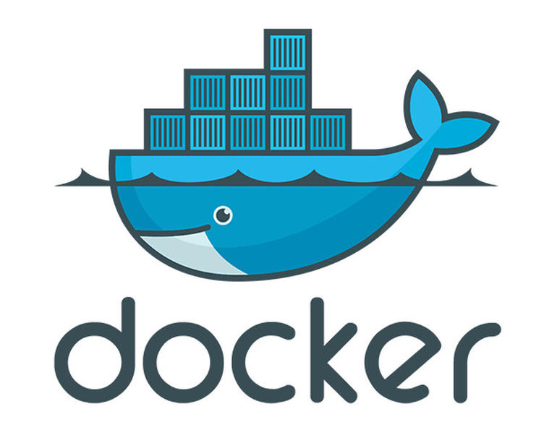


Agenda
Historie van Spring (Boot) - Ontstaan en veranderingen over laatste jaren; wat zijn de gedachten achter (Spring)Boot
Spring Boot in de praktijk - Een kort overzicht van praktijkervaringen opgedaan met Spring Boot in een Docker Container omgeving
Toelichting van de Labs - Korte omschrijving van de Labs en do’s en don’ts
17:45 – 18:30 Diner
18:30 – 21:00 Labs
1 – Your First REST API in Spring Boot (& Getting Started)
2 & 3 – Swagger API [Design First] and Swagger Hub
4 – Running Spring Boot REST API in Docker
5 – Testing Spring Boot REST API – unit & integration test
6 – REST API using JPA and PostgreSQL Database
7 – SOAP WebService using Spring Boot
8 – Run Spring Boot Application (Lab 1 REST API) on Oracle Application Container Cloud

Slide 3

Java

Slide 4

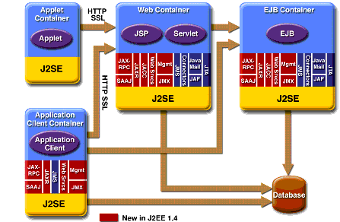
J2EE
1.4

Slide 5
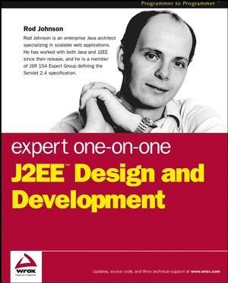
The Road to Spring
October 2002

Slide 6
POJO

Slide 7
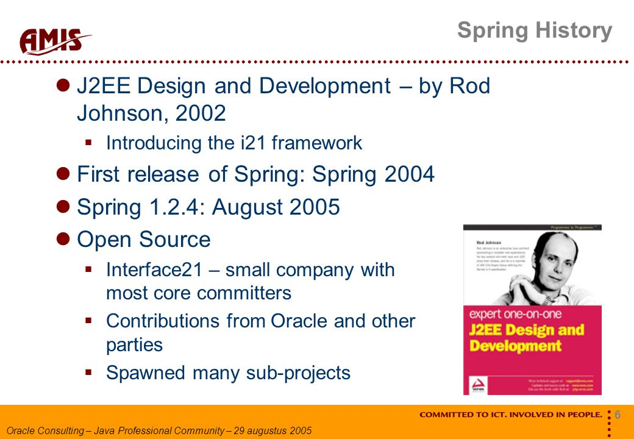
Notes:
http://slideplayer.com/slide/7452489/

Slide 8
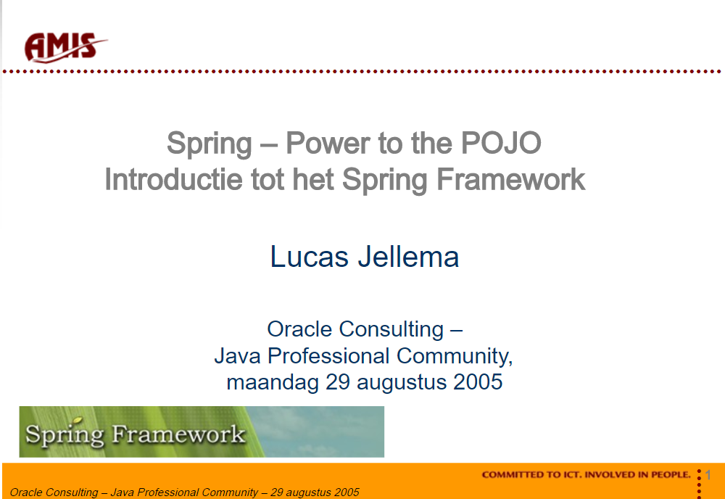
Notes:
http://slideplayer.com/slide/7452489/

Slide 9
Spring Fundamentals
Power to the POJO
Convention over configuration
Open for extension, closed for modification
Inversion of Control aka Dependency Injection
Objects are more cohesive because they are no longer responsible for obtaining their own collaborators.
When used with interfaces, code is very loosely coupled.
Spring Bean
Spring Bean
Spring Bean
Spring Bean

Slide 10

Spring Fundamentals
Power to the POJO
Convention over configuration
Open for extension, closed for modification
Inversion of Control aka Dependency Injection
Bean Factory
Class plus Config Settings & Bean References = Spring Bean
Spring Bean
Java Class
Spring Bean
Spring Bean
bean-config.xml
Spring Bean
Spring Bean Container

Slide 11
Spring Fundamentals
Power to the POJO
Convention over configuration
Open for extension, closed for modification
Inversion of Control aka Dependency Injection
Bean Factory
Class plus Config Settings & Bean References = Spring Bean
Spring Bean
Java Class
Spring Bean
Spring Bean
Annotations
Spring Bean
Spring Bean Container
“config”.properties

Slide 12
Template Pattern
Operations largely follows a standard algorithm
At certain steps, specialization or customization is required
Several implementations
Abstract ‘hook’ methods that sub-class may override
Parametrize behaviour and have invoker provide the details
Such as the SQL Query
For example: Spring JDBC Templates
Implement all JDBC wiring
Parametrize the query and the result-handling

Slide 13
(2005:) Spring’s recommended Application Guidelines and Architecture
Program against interfaces
For example Service Interface, DAO Interfaces
Typically no interfaces for Domain Classes
No configuration “plumbing” in your classes
Have configuration details injected
Domain Classes are used through all tiers
No Struts ActionForms to wrap domain classes
Controllers use Business Service methods to create or manipulate Domain Objects
[No DTOs]
Practice “Test driven development” (using Mock dependency injection by Spring during testing)
Agile Software Engineering methods, such as XP
First design and develop a test based on interfaces
Before implementing the interfaces
Before starting to resolve a bug
Automated Unit Testing for every class in the application

Slide 14
Spring’s recommended architecture
Presentation Tier
View Components
Generate HTML or PDF
Remote Service Exporters
Using SOAP, RMI, JAX-RPC etc.
Web Tier Actions
(Controllers)
Business Tier
Business Services Layer
Interfaces and Container Managed Implementations
Data Tier
DAO Interface Layer
Interfaces, independent of implementing DAO Technology
Persistent
Domain Objects
DAO Implementation layer
Retrieves, saves entities using ORM tool or JDBC
O/R Mapping Layer
JDBC
JDBC
RDBMS

Slide 15
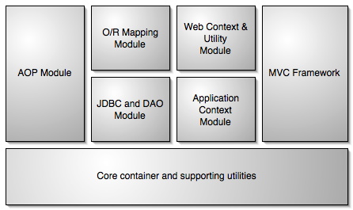

Slide 16
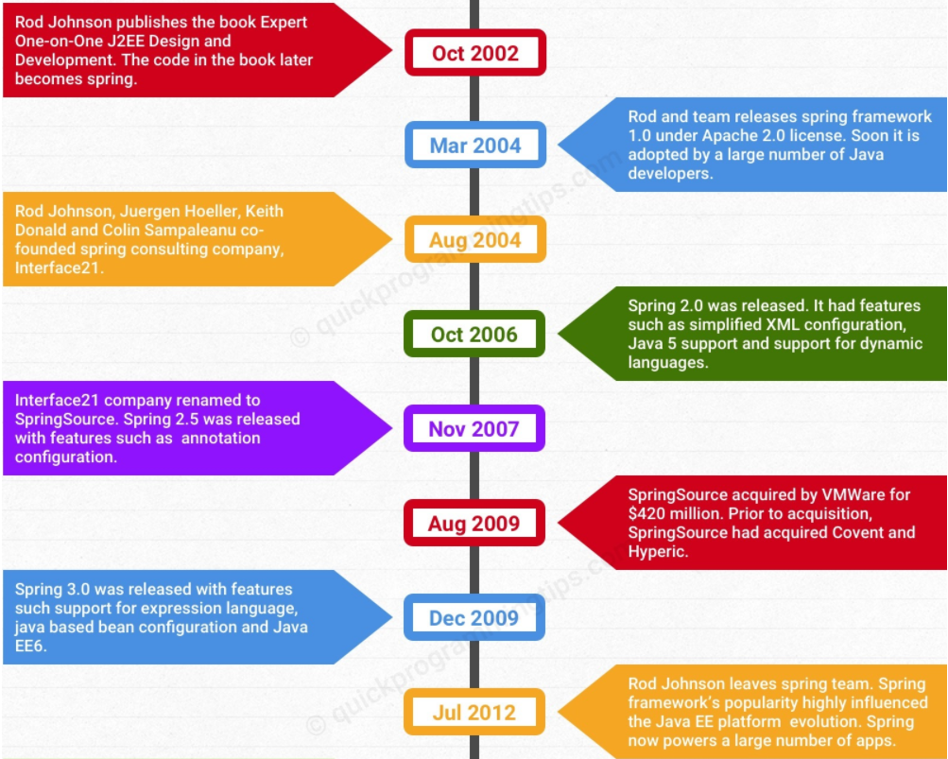

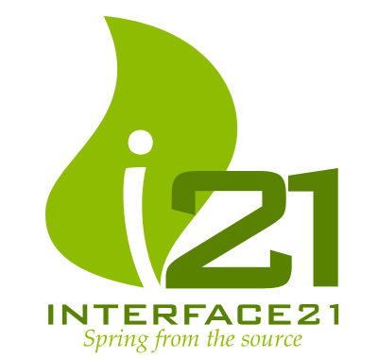





Spring History
6

Slide 17
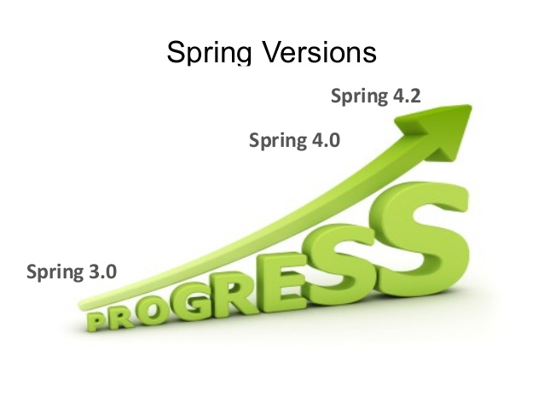
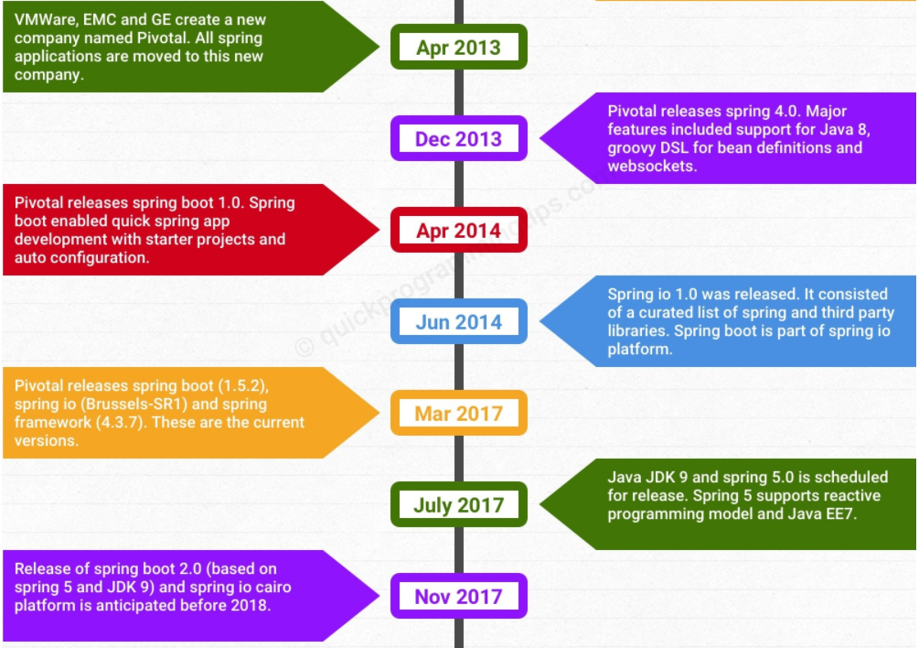







Spring History

Slide 18
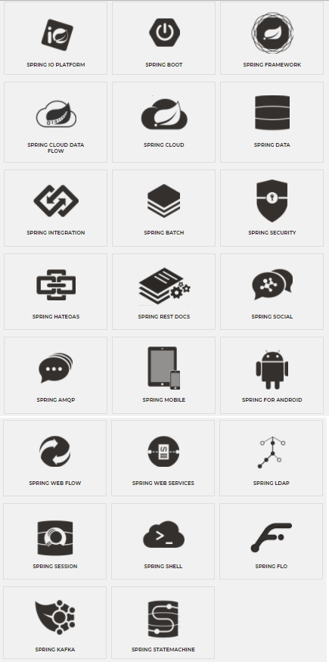
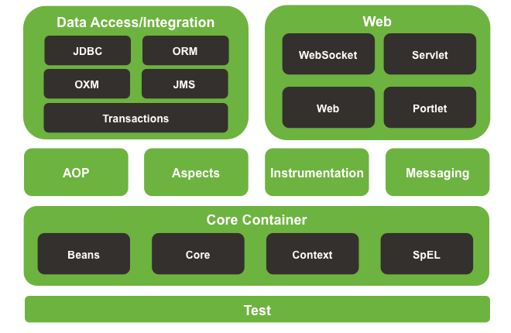
Spring Framework – extends far beyond a bean container

Slide 19
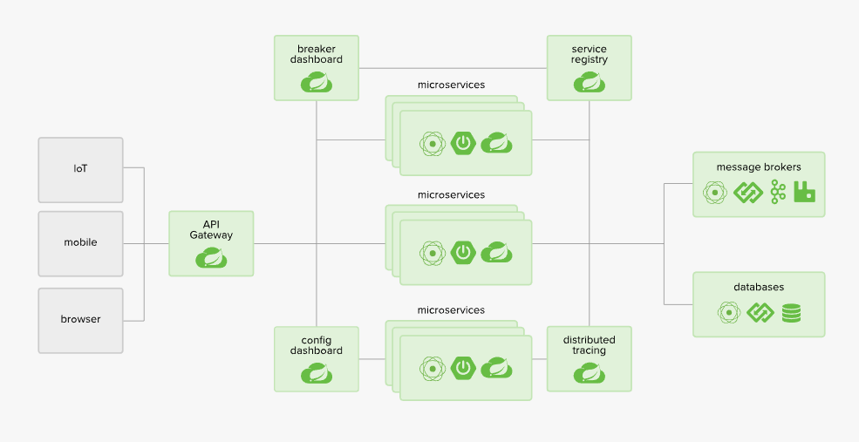
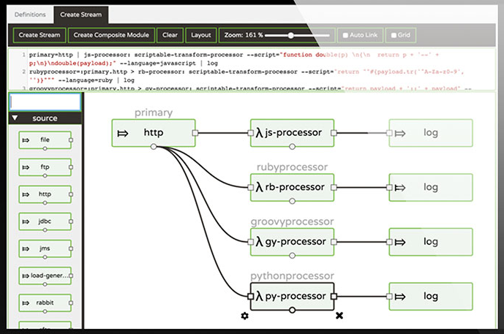
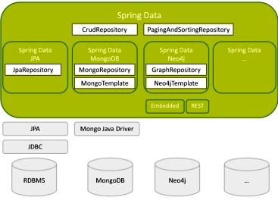
Spring – New Frontiers

Slide 20
Spring Boot Takes an opinionated view of building production-ready Spring applications. Spring Boot favors convention over configuration and is designed to get you up and running as quickly as possible.

Slide 21

Spring & Spring Boot but why?
Popular Java is very popular! #1 TIOBE index #3 on Stackoverflow and Github
Performant and Scalable Java outperforms JavaScript on Node if you do the same things – with much better monitoring, management, robustness
Quality & Productivity Spring provides templates and base classes for many crucial aspects of enterprise Java application, and enforces best practices – on top of standard Java platform – plus extensive support for testing
Rich in features Spring provides a lot of out of the box functionality such as integration and security, data access, messaging, web application, job scheduling
Fast and easy to start development Spring Boot makes it easy to create stand-alone, production-grade Spring based Applications that you can "just run". Preconfigured templates for Spring applications are available for many use cases – including Maven or Gradle configuration file
Notes:
https://octoverse.github.com/
https://insights.stackoverflow.com/survey/2017
Performance: https://www.linkedin.com/pulse/nodejs-vs-java-which-faster-apis-owen-rubel
Na application server required. Ideal to just run a Jar in a Docker container
Netflix uses it
Spring is a solid framework
a large codebase
many contributors
Spring Boot makes using Spring easy by taking an opinionated view Minimal configuration required for 80% of the use cases
Designed to get you up and running as quickly as possible.
Does not require an application server (has embedded Tomcat)
You just need a JVM to run

Slide 22
BUILD ANYTHING WITH SPRING BOOT
Spring Boot is the starting point for building all Spring-based applications. Spring Boot is designed to get you up and running as quickly as possible, with minimal upfront configuration.
Get started in seconds using Spring Initializr
Build anything - REST API, WebSocket, Web, Streaming, Tasks, and more
Simplified Security
Rich support for SQL and NoSQL
Embedded server runtime support - Tomcat, Jetty, and Undertow
Developer productivity tools such as live reload and auto restart
Curated dependencies – library versions - that just work
Production-ready features such as tracing, metrics and health status
Smart configuration setting:override hierarchy from environment variable to hard coded default
Works in your favorite IDE - Spring Tool Suite (on Eclipse), IntelliJ IDEA and NetBeans
Quickly build a ‘self contained, ready to run JAR’ (leveraging Maven or Gradle)

Slide 23

Boot?

Slide 24
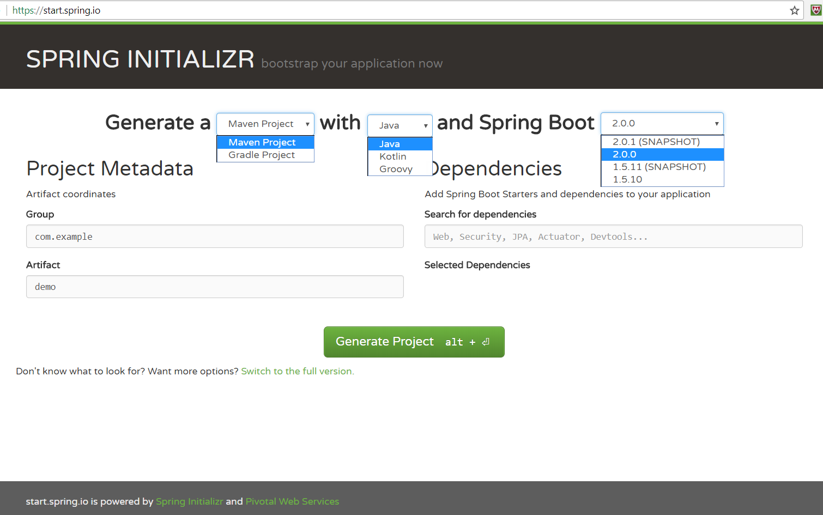
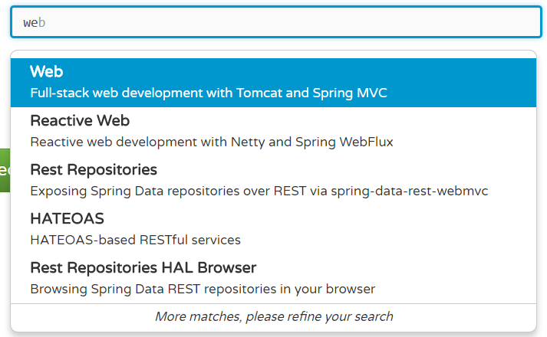
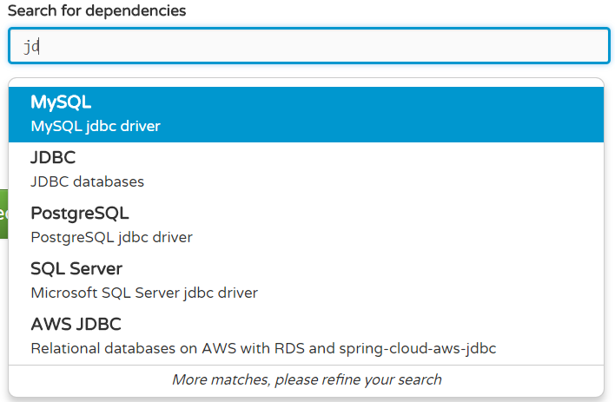
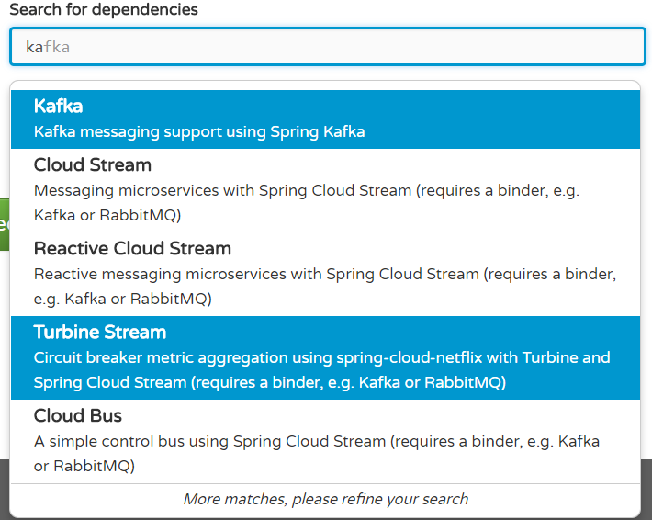
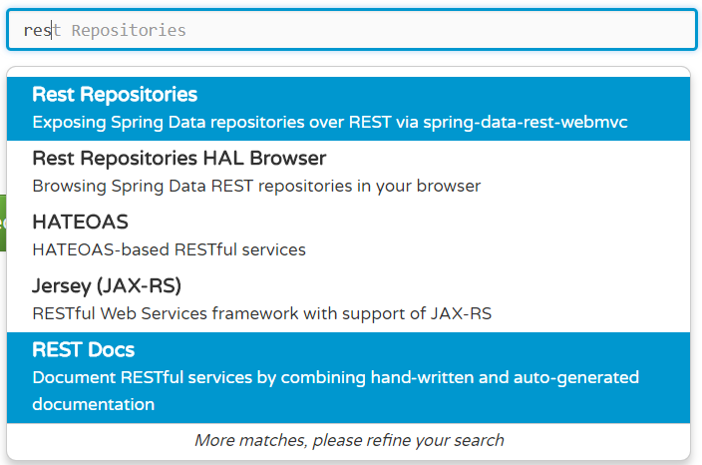

Slide 25



Spring Boot – Release History
2014
Release 1.0 GA
Spring io 1.0.0
1.1
2015
1.2 & Spring io 2.0.0 & Spring Boot 1.3
2016
1.4
2017
1.5
2018
Spring Boot Release 2.0 GA (March 2018) on top of Spring Framework 5.0
17 months work and over 6800 commits by 215 different individuals
Java 9, reactive web programming, Cassandra, CouchDB, MongoDB, redis, Quartz, Netty, HTTP/2, Micrometer based metrics, Kotlin support
Notes:
https://spring.io/blog/2018/03/01/spring-boot-2-0-goes-ga

Slide 26

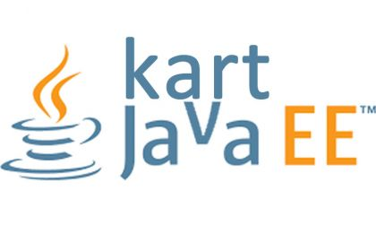
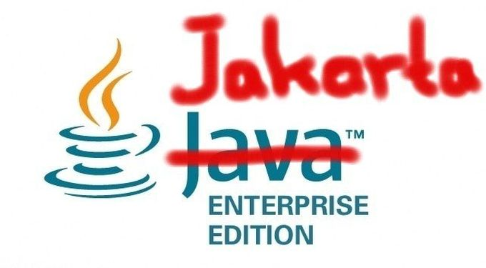





Slide 27




Thank you!
Blog: technology.amis.nl
Email: lucas.jellema@amis.nl
: @lucasjellema
: lucas-jellema
: www.amis.nl, info@amis.nl

